Slide 1
Applying Gamification to Teaching Cyber Security
Project Viva

Slide 2
Introduction
Problem Summary:
Despite the existence of many cyber security awareness programs, there is a lack of widespread cyber security awareness
Research Question:
Can teaching cyber security through a gamified medium improve cyber security awareness?
Notes:
In this project I wanted to combine the theory of game design with teaching cyber security as I’ve experienced cyber security illiteracy firsthand with my own family falling for phishing emails and fake websites.
As such, I set out with the research question: can teaching cyber security through a gamified medium improve cyber security awareness
In order to answer this, I reviewed pre-existing cyber security games that were available online, and the gamification mechanics that can be used in serious games.

Slide 3
Game Planning
Hypothesis:
The MDA framework will satisfy the educational requirements for creating a serious game
Notes:
After this research, it was found that designing serious games which are both fun and educational, is even more challenging than regular games.
However, it was clear that was a lack of multiplayer serious games available online, and that multiplayer and competition are two of the most effective game mechanics to facilitate learning. This was especially seen in Game of Threats, which is an industry paid training application, as well as Classcraft which is a subscription service.
From this, I decided to make a multiplayer board game using Mechanics-Dynamic-Aesthetics framework (which is the most popular and widely known framework for making games).

Slide 4
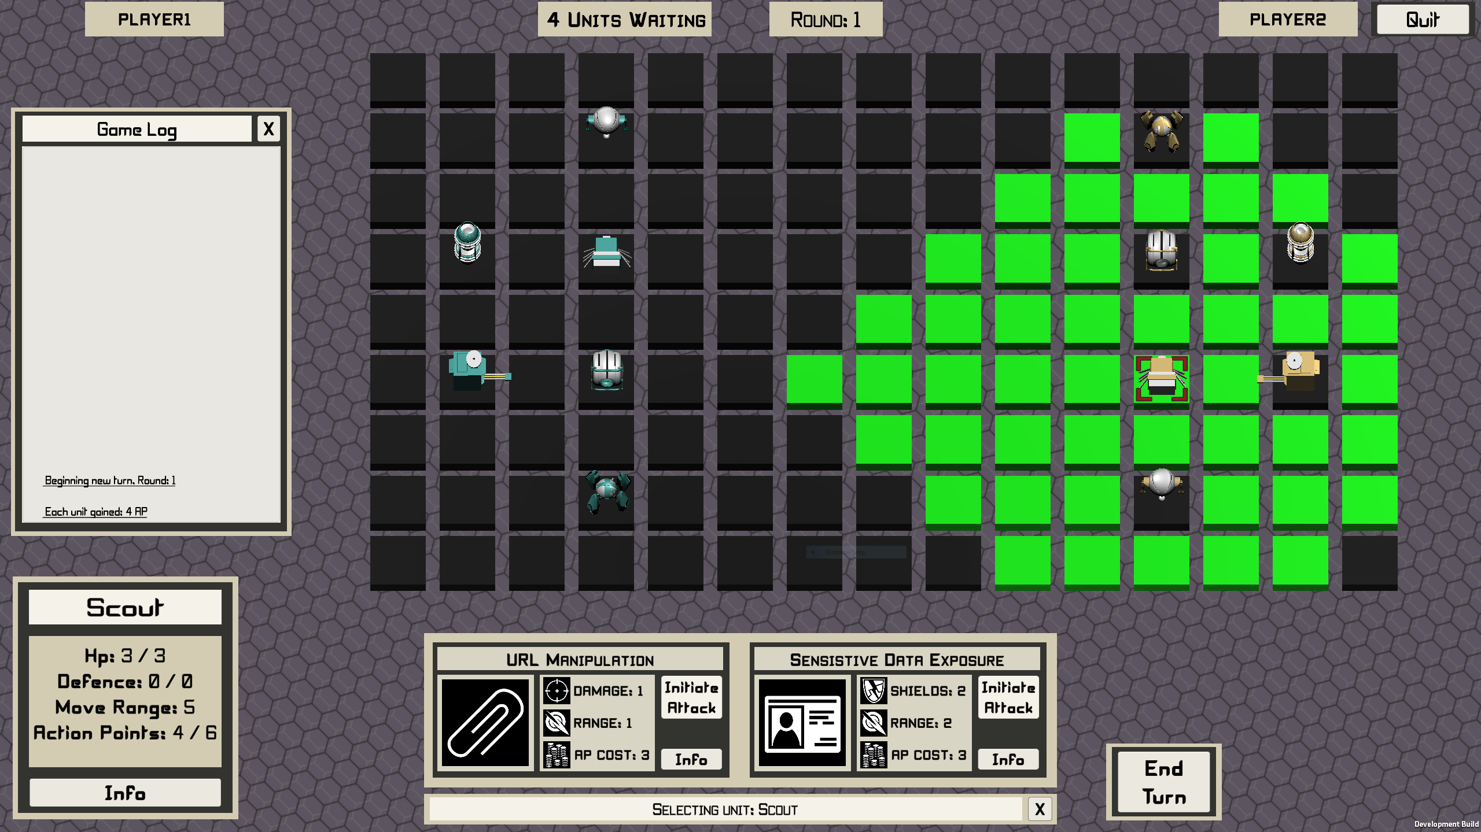
Related Work
Image of game
Notes:
Initially I was going for a Mario Party Style game that comprised of smaller scenarios, although I realized the complexity of this would be too large for this project.
As such, I reviewed as much related work of tabletop board games as I could, and I recorded the successes and criticisms of this work.
I then incorporated this feedback into my own project.
An example of this is having unit attack and defense cards in which both mindsets of defending and attacking a web application are explored.
Some other conclusions include the game style being familiar, actions having a cost requirement, and also using the OWASP Top Ten security risks to represent the information explored.

Slide 5
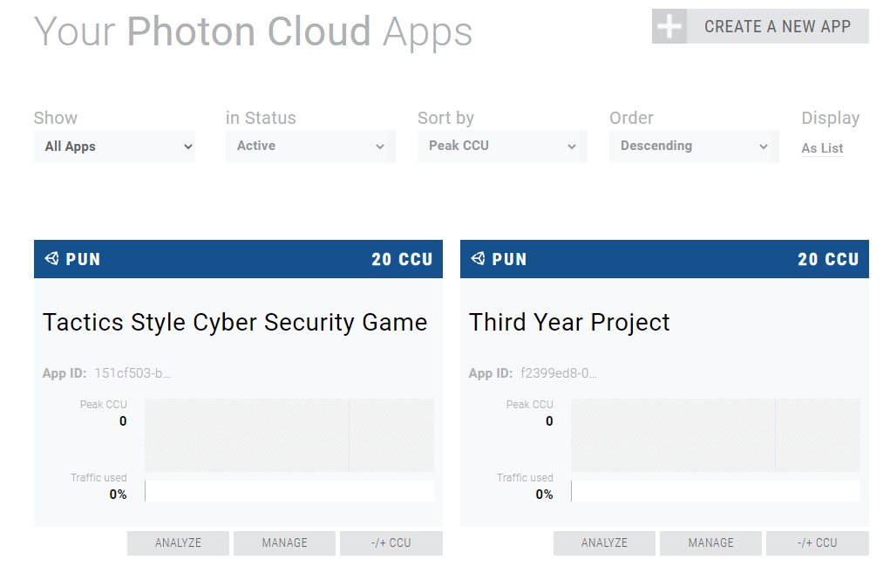
Design and Implementation
Photon Cloud Dashboard [1]
Notes:
This application itself was made with Unity and C# and is made up of 32 different scripts!
To make the game multiplayer, a cloud service called Photon Cloud was used to host the game, which is free up until 20 concurrent players.
This photo demonstrates the dashboard on their website, which allows you to control the game’s hosting.
To add multiplayer concurrency within the game, an API called Photon Unity Networking 2 was imported and used.
As this project required so much time developing the turn – based logic, multiplayer concurrency and the logic behind each unit’s movement and abilities, not as many educational mechanics were implemented as I initially wanted to, however the application is fully functional, and these ideas explored in the future work.

Slide 6
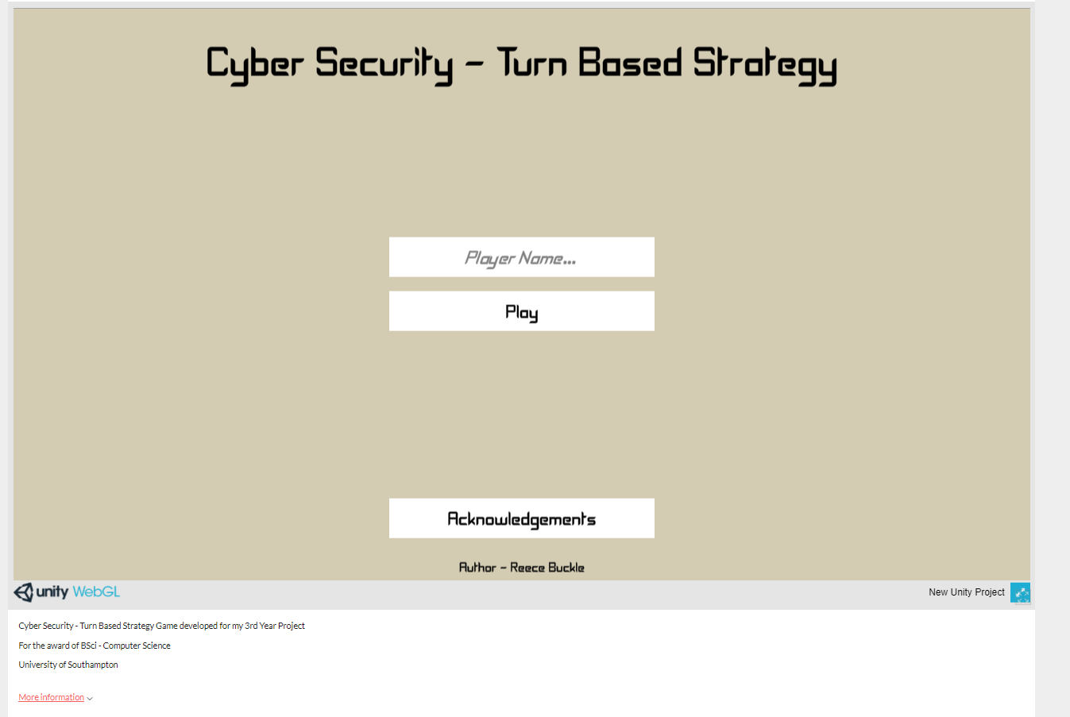
WebGL Application on Itch.IO
WebGL Private Listing on Itch.IO [2]
Notes:
The main game was compiled as WebGL 2.0 and uploaded to Itch.IO which is a free platform for sharing games.
You can access this with the password 123 (which I know is ironically bad for a cyber security themed project!)
There is also a tablet friendly version with an alternative UI that supports an aspect ratio of 4:3.
This main desktop version supports 16:9 and ultrawide 21:9 which are the most standard monitor aspect ratios.
There is also a non-web-based version which has some nicer stylized tiles, and runs at an even higher frame rate, however these tiles failed to render in WebGL so had to be removed online.
This is the connection menu. You enter your name, and it facilitates auto matching to a cloud server in your region (e.g., Europe).
This doesn’t support matchmaking between servers in different regions (such as the USA and UK however, as I tested with a VPN).
I did originally create a lobby system in which you can create and search for lobbies, however I reduced this to an auto-matchmaking system because it’s not necessary for 2 player games, or as clean

Slide 7
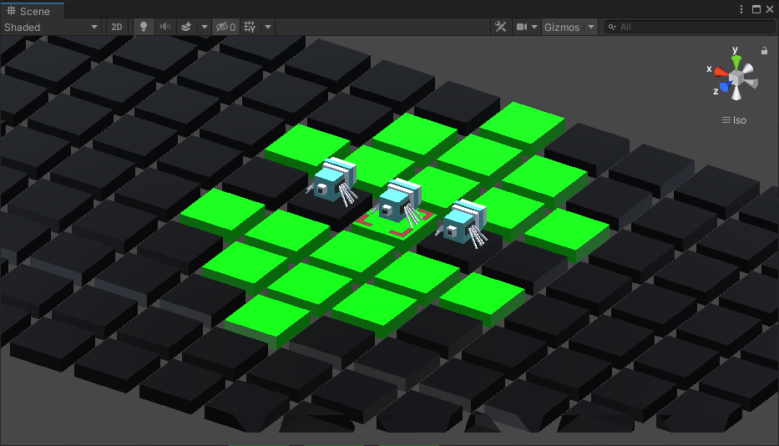
Path Finding – Breadth First Search
Breadth First Search
Notes:
Regarding the game, tile movement is calculated with Breadth First Search. Although this is not the most efficient pathfinding algorithm, it was used as it always returns the shortest path to the target tile which would make the most logical sense for this game, especially if it was to support movement after attacking again.
I did originally play around with A* search which worked nicely for single player AI units; however, it was decided from day one that this game would only support single player if multiplayer was too difficult to implement.

Slide 8
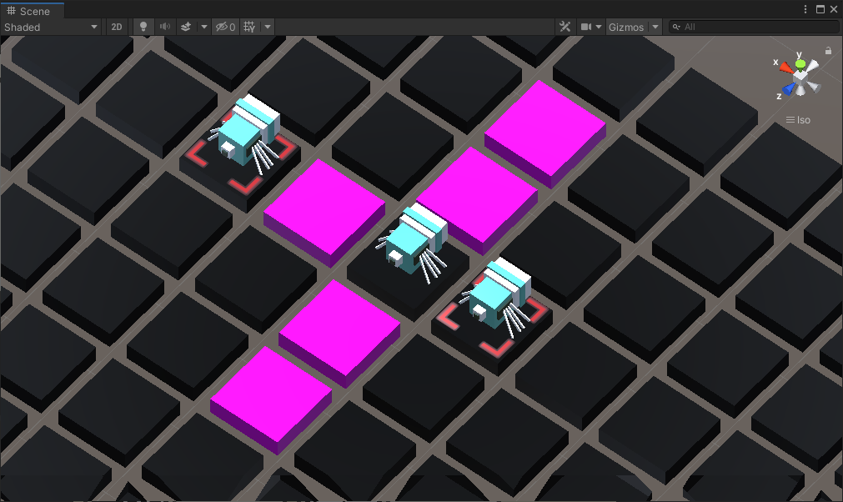
Using Abilities
Using Abilities
Notes:
When an ability is used, like classic tactics style games, each ability has a different effect and damage range.
The picture above illustrates this where unit abilities operate in a line-of-sight manor (which doesn’t utilize any pathfinding algorithms).
Ultimately both pathfinding and finding attack range work similar with ray-casts.
A ray-cast is like a laser beam which is sent downwards from the selected unit and returns the tile underneath. From each other tile, ray-casts are sent out to find neighbors.
At one point in development, using a 2D array list of tiles was heavily explored such that the entire gameworld mapped could be mapped to a data structure, however using ray-casts is a more flexible approach because it means we have 3- dimensional maps, holes present, and extend the number of tiles easily. Using a 2D array list also requires a certain amount of hard coding which would make the project harder to create new scenarios and scale in size later on.

Slide 9
Thank You for Watching
Image of game
Notes:
Thank you for watching
I’ll now demonstrate a short video of the game as I illustrate some of the key mechanics and gameplay on different systems (whilst sped up).

